Slide 1
The election in the U.S 2016
How it works

Slide 2
The United States of America is a republic
President
Election every fourth (4th) year
Maximum length of presidency 8 years
Two parties (Democrats and Republicans)
Election day 8th of November
President and Congress may be different

Slide 3
Preparation
Democrats and Republicans start off with 8-10 candidates
Campaigns throughout the States
The States give their votes
Two remaining candidates

Slide 4
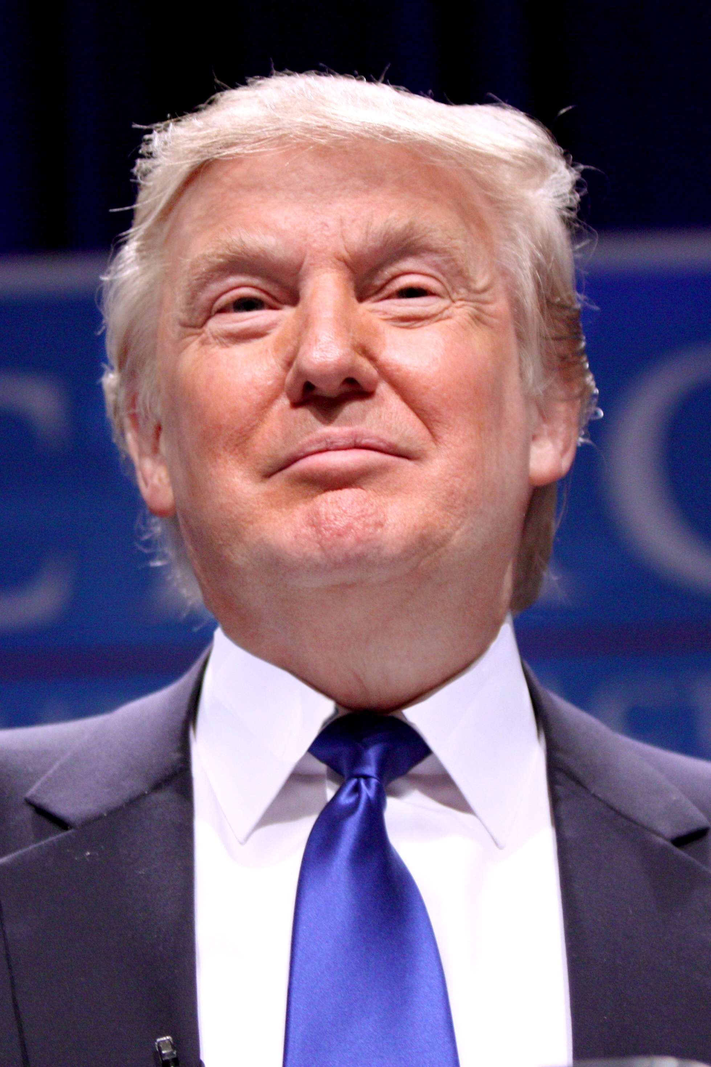
Donald Trump
Background
Personality
Vision

Slide 5
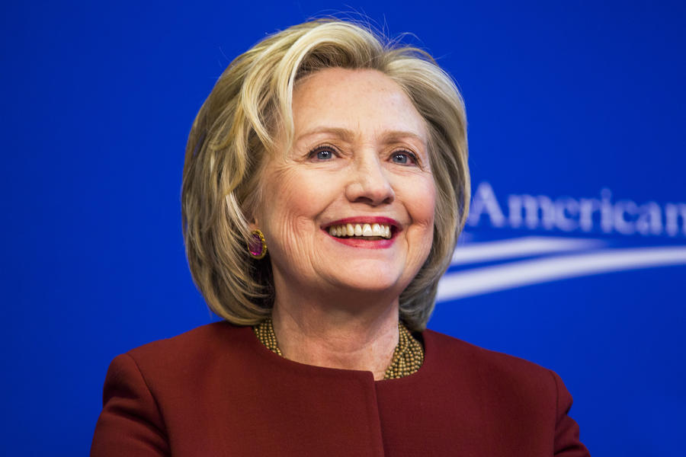
Hillary Clinton
Background
Personality
Vision

